Slide 1


CODE GENIE
AI Powered VS Code Extension
Vishesh Gupta
23BD1A663Y

Slide 2

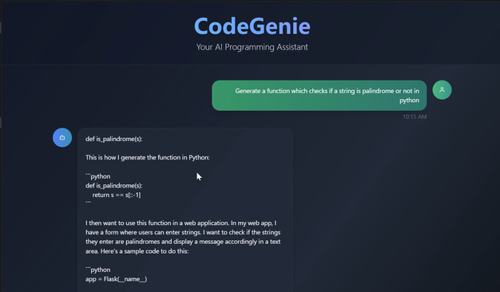
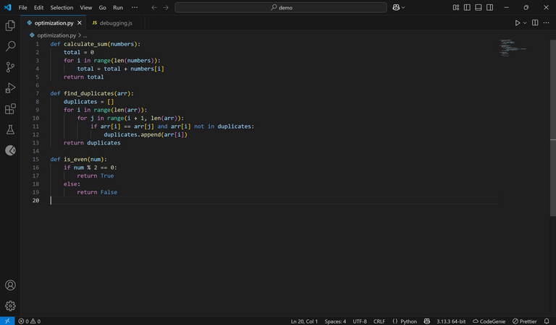

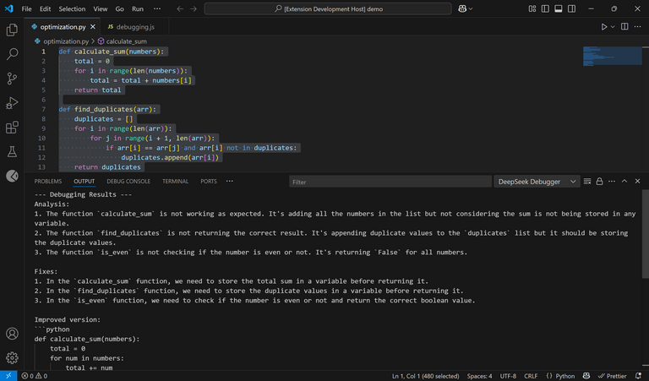
Architecture Diagram
Frontend
Backend
React.js + TypeScript + express js
Fast API
extension.ts
server.py
registered commands
Flask Server
model
Response
codegenie.start
StartCodeGenie
POST /api/generate
Response
codegenie.complete
ctrl+alt+c
POST /api/complete
DeepSeek Coder
codegenie.acceptGhostSuggestion
POST /api/auto-complete
Enable CodeGenie Extension
codegenie.fillInTheMiddle
ctrl+alt+8
POST /api/fill_in_the_middle
User
codegenie.optimize
ctrl+shift+o
POST /api/auto-complete
codegenie.debugCode
ctrl+shift+8
POST /api/debug
Response in output panel

Slide 3
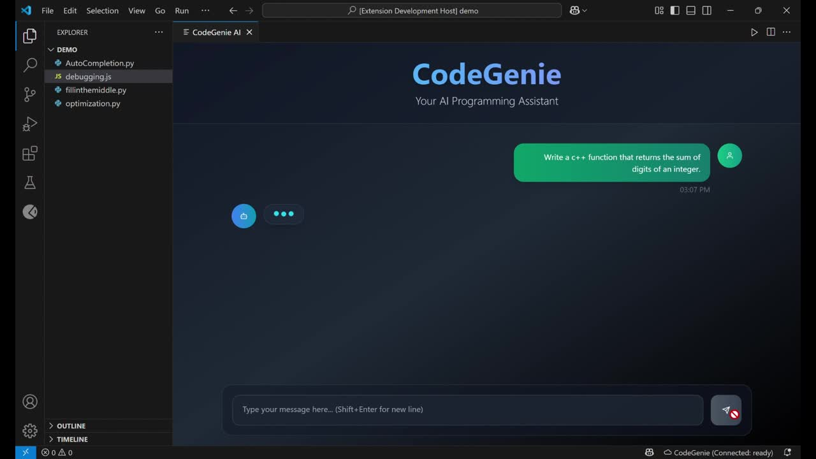

Slide 4

Key
Learnings
LLM
Inference
on GPU
Team Collaboration
Production Readiness
Performance
Improvisation

Slide 5
Why
DeepSeek Coder?
✨ Crafted with intention for the art of code generation.
Why other models like StarCoder and Code Llama are not used??
🌐 Robust support for a symphony of languages.
We encountered challenges in achieving optimal performance and smooth integration with alternative models.
⚡ Swift inference, finely tuned for the tapestry of real-time engagement.
👨‍💻 Perfectly suited for vibrant live coding realms within VS Code.

Slide 6
Challenges
Faced
Integrating LLM Inference in Real-Time
Handling Model Integration Failures
Applying SDLC in a Fast-Paced Environment

Slide 7

THANK
YOU

